Slide 1
NYC EMS Incident
Dispatch Data Analysis
ALY 6140 Capstone Project · Jeff Hackmeister
Northeastern University · 2025–2026
NYC Open Data · 2023–2025 · 3.19 Million EMS Incidents
Notes:
Welcome, and thank you for the opportunity to present my capstone project for ALY 6140.
My name is Jeff Hackmeister, and today I'll be walking you through an analysis of New York City's Emergency Medical Services dispatch data. The dataset comes from the FDNY's Computer Aided Dispatch system and covers roughly 3.19 million incidents between 2023 and 2025.
The central question driving this work is straightforward but important: can we use operational dispatch data to better understand EMS performance — and identify where the system may be leaving certain communities underserved?
Let's get started.

Slide 2
Agenda
01
Background
The challenge of urban EMS in NYC
02
Research Questions
What we set out to learn
03
Data & EDA
Dataset overview and key visual findings
04
Predictive Models
Regression, Clustering, and KDE
05
Conclusions
Key findings and future directions
Notes:
Here's a quick roadmap of what we'll cover today.
We'll start with some background on why urban EMS is such a complex problem and why New York City is a particularly interesting case study. From there I'll walk through the three research questions that framed the analysis.
The bulk of the presentation covers the data — how it was prepared, what the exploratory analysis revealed, and the three modeling approaches I used. We'll close with conclusions and some thoughts on where this work could go next.
The whole presentation should run about 12 to 15 minutes.

Slide 3
Background
The Urban EMS Challenge
About the Dataset
EMS speed is often the difference between life and death — especially for cardiac arrest, stroke, and trauma
NYC's density, traffic, geography, and socioeconomic disparity all complicate response
Efficient, equitable service requires continuous data-driven evaluation
Source: NYC FDNY EMS Computer Aided Dispatch (CAD) system via NYC Open Data
Filtered: January 2023 – December 2025 (post-pandemic baseline)
Scale: 3.19 million incidents retained after filtering from 28.7M total rows
5 key columns selected: datetime, borough, call type, response seconds, ZIP code
Notes:
Let me set the stage for why this analysis matters.
EMS response time is not just an operational metric — it is a direct determinant of patient outcomes. For cardiac arrest, for stroke, for severe trauma, every additional minute without intervention measurably reduces survival and recovery odds. In a city like New York, delivering consistent response times across all five boroughs is an enormous logistical challenge.
Population density, traffic congestion, building access, and socioeconomic factors all interact in ways that create real disparities in who gets help quickly and who doesn't.
The dataset used here was filtered from the full NYC Open Data portal — which contains 28.7 million rows going back many years — down to a post-pandemic window of 2023 through 2025. That gave us 3.19 million incidents to work with, using five key columns: timestamp, borough, call type, response time in seconds, and ZIP code.

Slide 4
Research Questions
Q1
How is EMS call volume distributed across NYC's five boroughs and over time?
Q2
What factors are most strongly associated with longer EMS response times?
Q3
Are there spatial or temporal patterns that signal resource allocation opportunities?
Notes:
The analysis was built around three research questions.
First, how is call volume distributed across the city's five boroughs and over time? We want to understand the baseline demand patterns before drawing any conclusions.
Second, what factors are most strongly associated with response time? We're particularly interested in whether borough, time of day, or call type have measurable effects.
And third, are there patterns in the data that point to resource allocation opportunities — places or times where demand and response time suggest the system is stretched?
Keep these three questions in mind as we move through the findings.

Slide 5
Exploratory Data Analysis — Data Overview
3.19M
2023–25
5
120 min
Incidents Analyzed
Study Period
Feature Columns Used
Response Time Cap
Data Preparation
Timestamp parsed with explicit format string to prevent inference warnings
Response times ≤ 0 excluded (likely CAD positioning errors); times > 120 min excluded as outliers
Derived time features added: HOUR, DAY_OF_WEEK, MONTH, YEAR, RESPONSE_TIME_MIN
ZIP code had elevated missing data rate — spatial analysis kept at borough level
Missing data assessment used a custom function; borough and call type fields were near-complete
Notes:
Let's talk about how the data was prepared.
After filtering on the portal, we started with 3.19 million rows. Five columns were retained: incident datetime, borough, final call type, response time in seconds, and ZIP code. From those we derived five additional features — hour of day, day of week, month, year, and response time in minutes.
Two cleaning decisions are worth noting. Response times of zero or less were removed — these typically indicate a unit already on scene when the call came in. Response times over 120 minutes were removed as likely CAD errors.
A missing data check showed that borough and call type fields were nearly complete. ZIP code had a higher rate of missing values, which is why geographic analysis was kept at the borough level rather than ZIP code level.

Slide 6
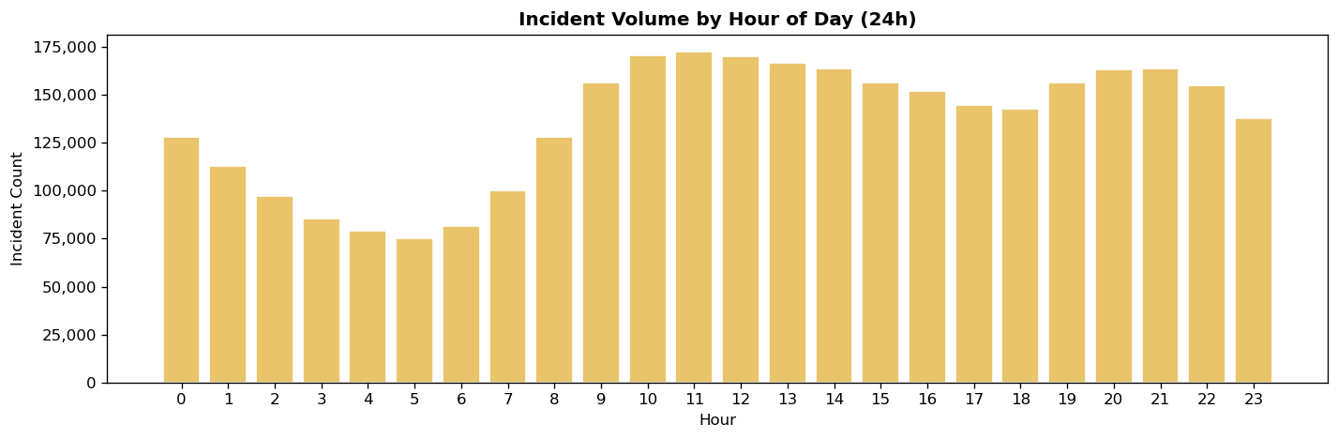
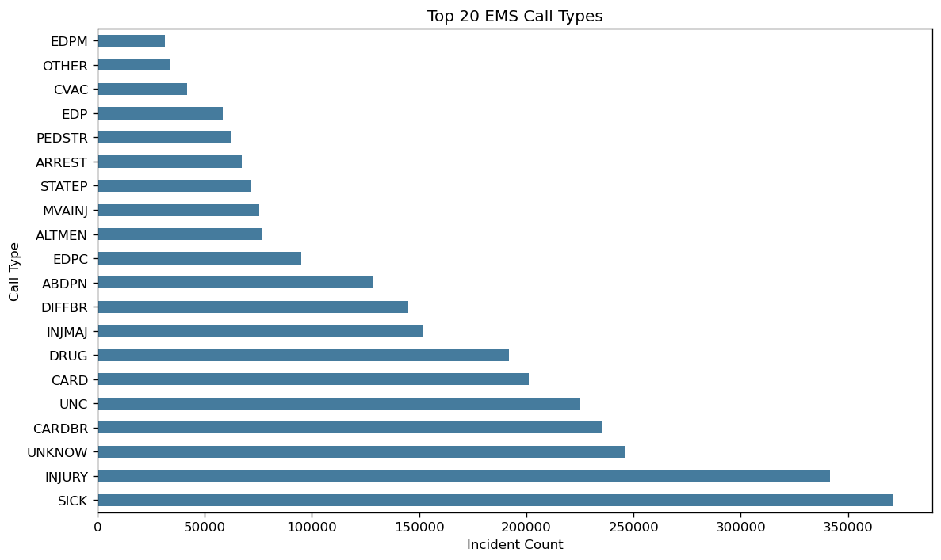
Exploratory Data Analysis — Data Overview
Key Observations
Incidents by Hour of Day
Incident volume dips sharply in the early morning hours (2–5 AM), peaks around 11 AM
Volumes are noticeably lower on weekends vs. weekdays (heatmap pattern)
Top call types: Sick and Injury dominate; EDPM (psych), Other, and CVAC (stroke) follow
Call Type Analysis
Top 20
Notes:
These two charts show the temporal demand pattern and the breakdown of call types across the full dataset.
On the hour of day chart — the volume drops sharply overnight, reaching its lowest point around 3 to 4 AM, then climbs steadily through the morning and stays elevated from around 10 AM through midnight. This pattern is consistent across all three years and has clear staffing implications.
On the call type chart — the top 20 types are shown here using their CAD codes. SICK and INJURY dominate by a wide margin, together accounting for a substantial share of all incidents. Further down you have categories like CARD for cardiac, CARDBR for cardiac arrest, UNKNOW for unknown, and UNC for unconscious. At the bottom of the top 20, EDPM covers non-violent psychiatric patients and CVAC covers critical stroke calls. The concentration in a handful of call types means that targeted protocols for these categories could have outsized system-wide impact.

Slide 7
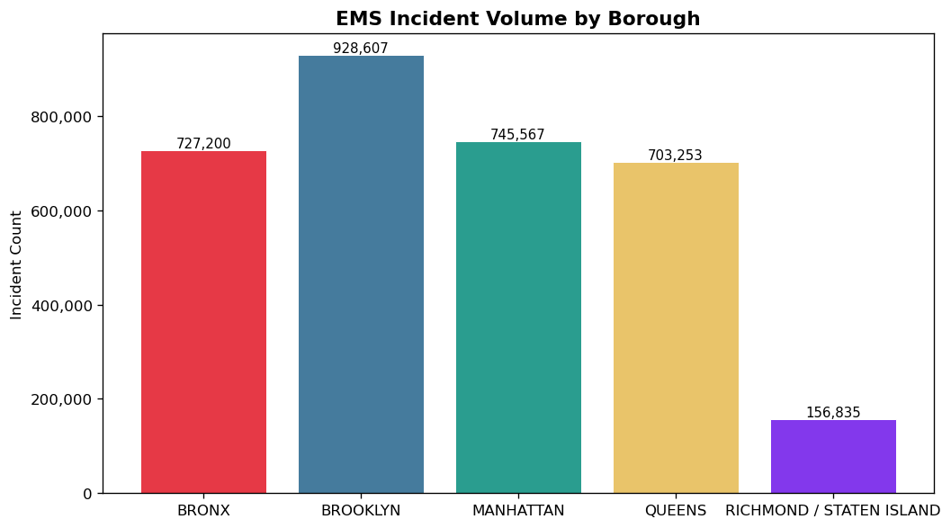
EDA — Call Volume Patterns
Key Observations
Brooklyn and Manhattan lead in total volume, consistent with population density
Bronx volumes are quite high per capita – population far smaller than Brooklyn or Manhattan
Staten Island has by far the fewest calls — smallest population of the five boroughs
Notes:
Moving into the borough-level findings.
Looking at the actual counts from the chart: Brooklyn leads with just over 928,000 incidents, followed by Manhattan at 745,000, the Bronx at 727,000, Queens at 703,000, and Staten Island at just 156,000.
The ordering here is worth pausing on. Brooklyn's lead is expected given its population, but the Bronx ranking a close third — just behind Manhattan — is notable. The Bronx has a smaller population, which means its incident rate per capita is actually quite high. That becomes an important thread when we get to the response time findings.
Staten Island's volume is dramatically lower, consistent with it being the least populous borough by a significant margin.

Slide 8
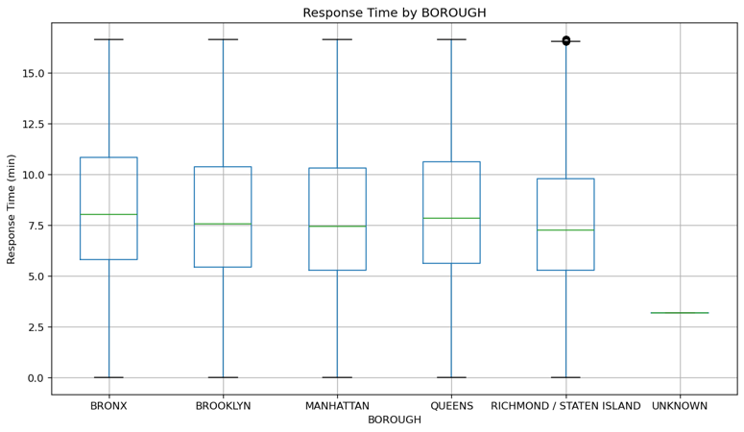
EDA — Response Time by Borough
Kruskal-Wallis Test
H = 11,448.46
p ≈ 0.000
Takeaways
All 5 borough pairs are statistically significantly different (Bonferroni-corrected p < 0.05)
Differences are <1 minute — but in EMS, seconds matter
The Bronx is consistently the slowest borough
Notes:
When we look at response time by borough, the boxplot tells an interesting story.
The green line inside each box is the median. Visually, the Bronx sits noticeably higher than Manhattan, Brooklyn and Queens, with Staten Island showing the lowest median — but also a very compressed interquartile range and an unusually clean low end.
One thing to flag here: you'll notice an UNKNOWN category on the far right. These are records where borough was not captured by the CAD system. They have a notably low median response time with a tight distribution — which likely reflects incidents that were closed quickly or involved errors in data entry. These were kept in the dataset for completeness but excluded from the borough-specific analysis.
On the statistical test: the Kruskal-Wallis H of over 11,000 with a p-value effectively at zero confirms that the differences between all five boroughs are real. The post-hoc pairwise comparisons, showed every single borough pair is significantly different. The absolute differences are under a minute — but in cardiac arrest response, one minute changes survival odds meaningfully.

Slide 9
Model 1 — Multiple Linear Regression
RMSE
R²
Model explains only ~0.13% of variance in log-transformed response time
0.4163
0.0013
Approach
Interpretation
Predictors: BOROUGH, HOUR, DAY_OF_WEEK, FINAL_CALL_TYPE
Log-transform applied to correct right-skew in response times
80/20 train-test split with fixed random seed (42) for reproducibility
Categorical variables label-encoded prior to fitting
Evaluated using RMSE and R² on held-out test set
The low R² confirms that borough, hour, day, and call type alone cannot reliably predict response time
EMS response is driven by many unmeasured factors: unit location at dispatch, traffic, building access, crew availability
Despite poor fit, the model is still useful — it confirms that structural features like borough matter
Future work: add unit GPS positions, weather, and traffic data
Notes:
The first model used multiple linear regression to predict response time from borough, hour of day, day of week, and call type.
A log transformation was applied to the response time column to address the right-skewed distribution common in time-to-event data. The dataset was split 80/20 for training and testing with a fixed random seed.
The results were honestly quite poor: an R-squared of 0.0013 means the model explains less than two-tenths of one percent of the variance in response time. The RMSE on the log scale was 0.42.
This is actually an informative finding in its own right. It tells us that the structural features available in the CAD system — borough, time of day, call type — are simply not enough to predict how long an individual response will take. The variation is driven by factors not captured here: where the nearest unit was at dispatch, real-time traffic, building access, crew readiness. Future modeling efforts need that richer data to produce something useful for operational decisions.

Slide 10
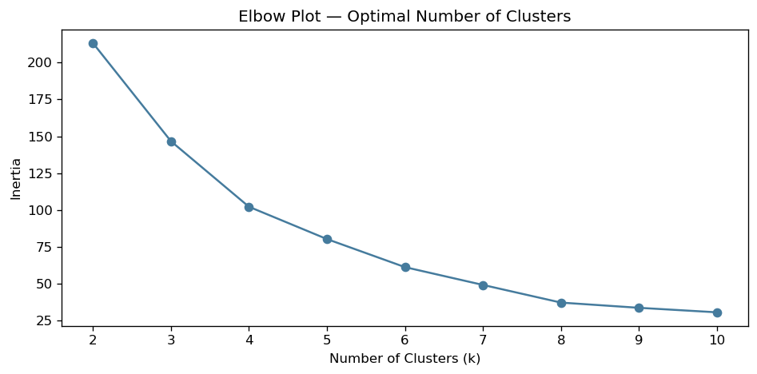
Model 2 — K-Means Clustering
Methodology
Aggregated data by BOROUGH × HOUR: total incident count + avg response time per cell
Features normalized (z-score) before clustering
Elbow plot tested k = 2–10; k = 5 selected (one natural group per borough)
n_init = 10 with fixed random seed for stable results
Cluster profiles: avg incidents, avg response time, and peak hour per cluster
Notes:
The second model took a different approach. Rather than trying to predict individual response times, K-Means clustering was used to identify natural groupings of demand patterns across the system.
The feature matrix was built by aggregating to the borough-by-hour level — so each data point represents one borough at one hour of the day, with total incident count and average response time as the features. Those were then normalized using z-scores before clustering.
Looking at the elbow plot on the right — the inertia drops steeply from k equals 2 to k equals 4, then begins to flatten out. The transition is gradual rather than a sharp elbow, which is typical for this type of demand data. K equals 5 was selected as a reasonable stopping point, and as we'll see on the next slide, that choice turned out to be very interpretable — because each cluster maps cleanly onto one of the five boroughs.

Slide 11
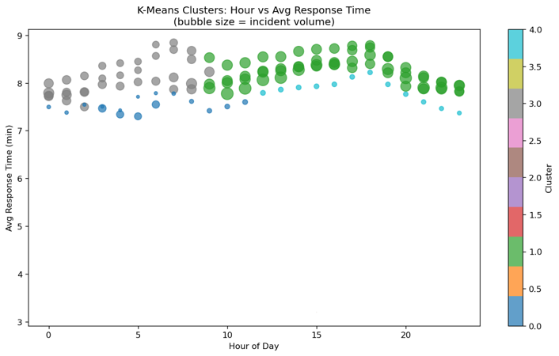
Model 2 — K-Means Clustering
Findings
Clusters aligned primarily by borough — each borough formed a distinct demand pattern
Time of day had a relatively small impact on which cluster a data point fell into
Bronx cluster: highest avg response time, moderate incident volume
Manhattan cluster: very high incident volume but competitive response times
Staten Island cluster: lowest volume and best response times across the day
Result suggests targeting Bronx-specific resource increases would have the most impact
Notes:
This bubble chart shows the clustering result. The x-axis is hour of day, the y-axis is average response time in minutes, and bubble size represents incident volume. The color coding on the right identifies each cluster.
What jumps out immediately is the horizontal banding — there are distinct tiers of average response time that remain fairly consistent across all hours of the day. The top band, sitting around 8 to 9 minutes, corresponds to the Bronx cluster. The bottom band, around 3 to 4 minutes, is Staten Island. Manhattan, Brooklyn, and Queens fall in between.
The key insight here is that the bands don't cross or merge as you move across the hours. If time of day were the dominant driver, you'd expect to see convergence overnight and divergence during peak hours. Instead, the cluster structure stays stable — confirming that borough identity is the dominant differentiator, not time of day.
From a resource allocation standpoint, this points to structural borough-level differences that can't be solved by redistributing shifts. They require borough-specific investments.

Slide 12
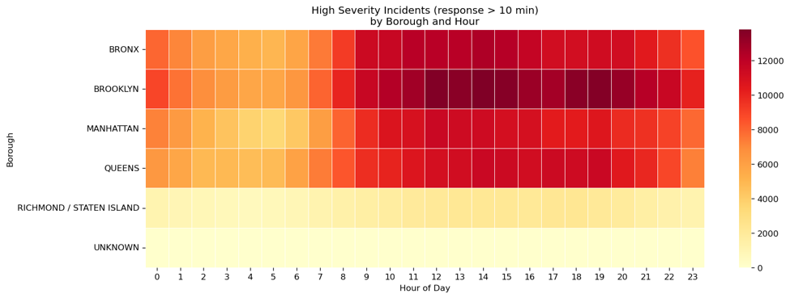
Model 3 — Kernel Density Estimation (KDE)
Method
Non-parametric KDE — no distributional assumptions
Heatmap by Borough & Hour
Brooklyn and the Bronx have the highest concentration of high-severity incidents
Peak concentration in midday to evening hours
Manhattan shows elevated severity volumes but shorter tail — faster resolution
Staten Island shows lowest high-severity density across the day
Notes:
The third model used Kernel Density Estimation to characterize the distribution of response times and identify high-severity incidents.
On this slide we're looking at the heatmap of high-severity incidents — defined as response times exceeding 10 minutes — broken down by borough and hour of day.
The color scale goes from light yellow at low counts to deep red at high counts. A few things stand out immediately. The Bronx row is consistently dark red across almost all hours, with only a slight dip in the very early morning. Brooklyn is similar, though slightly lighter. Manhattan shows moderate severity counts but also sustains them throughout the day. Queens is lighter than both, and Staten Island is the lightest row by far — mostly yellows and light oranges.
The UNKNOWN row appears again here, with very low counts — consistent with what we saw in the boxplot.
The midday-to-evening intensification is visible across all boroughs, confirming that the afternoon and evening hours are when the system is under the most stress.

Slide 13
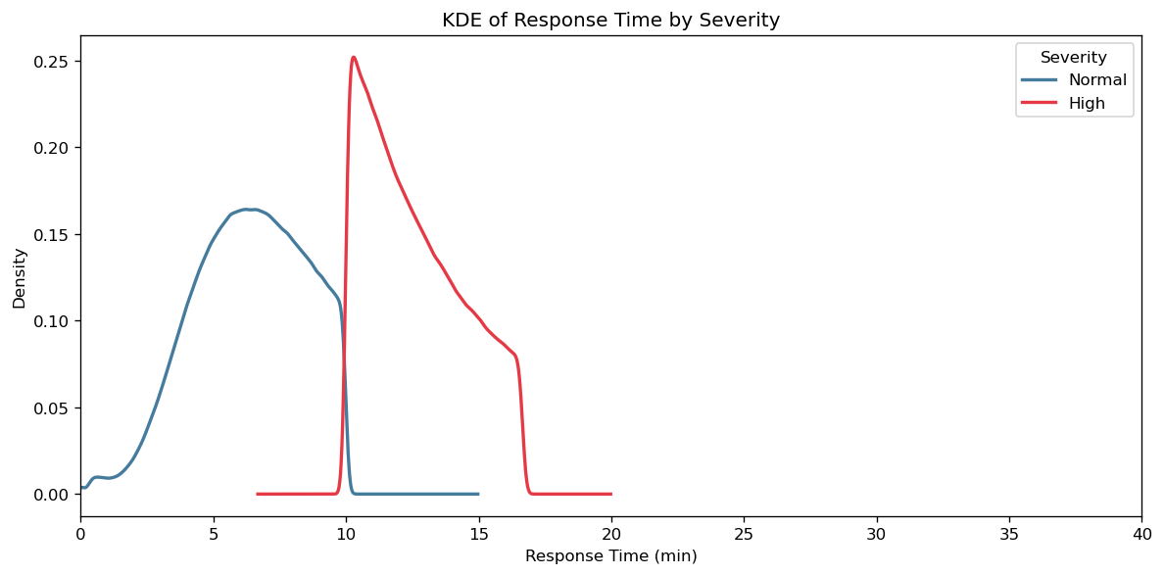
Model 3 — Kernel Density Estimation (KDE)
Severity Threshold
10 minutes (industry standard)
KDE Curve Findings
Two groups: Normal (<10 min) and High Severity (≥10 min)
High severity curve spikes sharply at the 10-minute threshold
Considerable tail extending to ~20 minutes for high-severity incidents
Distribution shape confirms skewness seen in EDA — most incidents are resolved quickly
Notes:
On this slide we're looking at the KDE curves themselves — the blue curve is the Normal group, meaning response times under 10 minutes, and the red curve is the High Severity group at 10 minutes or above.
The Normal curve peaks sharply around 6 to 7 minutes, which aligns with the median response times we saw in the boxplot. It drops off quickly on both sides, indicating a tight, well-behaved distribution for the majority of calls.
The High Severity curve tells a different story. It spikes very sharply right at the 10-minute cutoff — which by definition is where it starts — and then has a substantial tail that extends out toward 20 to 25 minutes, with a long, slow decay beyond that.
This sharp spike at exactly 10 minutes is actually meaningful. It's not a natural distribution feature — it reflects calls that just crossed the threshold. The long tail represents the truly delayed responses, where something went meaningfully wrong: a unit wasn't close, traffic was severe, or the call was mis-triaged initially.
Together, these two charts tell us that most of the system performs well most of the time. The problem is concentrated in a specific subset of incidents — and as the heatmap showed, those incidents cluster heavily in the Bronx and Brooklyn.

Slide 14
Findings Summary
Call Volume
Brooklyn and Manhattan lead in total incident volume. Peak demand is midday; lowest volumes occur 2–5 AM and on weekends.
Response Equity
The Bronx has the slowest median response times and the highest concentration of high-severity incidents — despite not having the highest call volume.
Regression Limits
Borough, hour, day, and call type explain only ~0.13% of response time variance. Unmeasured factors dominate — unit location, traffic, and crew availability are key missing variables.
Clustering Insight
K-Means confirmed borough as the dominant demand differentiator. Time-of-day effects were present but secondary. Five natural clusters emerged, aligned with the five boroughs.
Severity Hotspots
KDE analysis shows a clear severity spike at 10 minutes. The Bronx and Brooklyn have the highest density of delayed responses during midday–evening hours.
Notes:
Let me bring all five findings together before we close.
On call volume: Brooklyn leads the city, but the Bronx punches well above its weight relative to population. The temporal pattern is clear — early morning is quiet, midday through evening is peak demand.
On response equity: the Bronx is the consistent outlier. Slowest median times, highest severity concentration, and high per-capita call volume. That combination in the most economically disadvantaged borough is the central equity finding of this study.
On the regression model: the near-zero R-squared is a finding, not just a limitation. It tells us the CAD system alone lacks the data needed to predict individual response times. The unmeasured variables — unit location, traffic, crew state — are where the real predictive signal lives.
On clustering: borough dominates. K-Means produced five stable clusters that map directly onto the five boroughs. Time-of-day effects exist but don't change the fundamental structure.
And on severity: KDE shows a clear concentration of delayed responses in the Bronx and Brooklyn, peaking in the afternoon and evening hours.

Slide 15
Conclusions & Future Directions
Conclusions
Future Work
EMS response data reveals meaningful borough-level inequities that are statistically significant
The Bronx — NYC's most economically disadvantaged borough — faces the slowest times, highest severity, and high call volume relative to population
CAD data alone is insufficient to model response time; the system is complex and requires richer data
Data-driven analysis of dispatch systems can be a powerful tool for civic leaders seeking systemic improvements
Integrate unit GPS location at time of dispatch to measure travel distance
Incorporate real-time traffic data (e.g., NYC DOT API) to account for congestion effects
Add weather data to assess impact of precipitation and temperature on response times
Explore gradient boosted tree models (XGBoost) for improved predictive performance
Expand geographic resolution from borough to ZIP code level with imputed coordinates
Notes:
Pulling back to the big picture, this study makes two things clear.
First, there are real and statistically significant response inequities across NYC's boroughs, and the Bronx bears a disproportionate burden. It has the slowest response times, the highest concentration of high-severity incidents, and elevated per-capita call volume — all while being the least economically resourced borough. That combination makes a data-supported case for targeted investment in Bronx EMS capacity.
Second, CAD data alone has real limits as a predictive tool. The regression result isn't a failure — it's a finding. It tells us we need unit location at dispatch, traffic conditions, and weather data before we can build something operationally useful for predicting response times in real time.
Despite those limitations, this analysis demonstrates that systematic interrogation of dispatch data has genuine value for civic decision-making. We can identify where the system is strained and make a data-driven case for where resources should go.
On future work: the three highest-priority enhancements would be GPS unit location at dispatch, real-time traffic feeds like the NYC DOT API, and weather data. On the modeling side, gradient boosted models like XGBoost would likely outperform linear regression substantially once that richer feature set is available. Expanding geographic resolution to ZIP code level with imputed coordinates would also allow much more granular analysis than borough-level aggregation permits.

Slide 16
Thank You
Questions & Discussion
Jeff Hackmeister · ALY 6140 Capstone · Northeastern University
Data: NYC Open Data — EMS Incident Dispatch Data (2023–2025)
https://data.cityofnewyork.us/Public-Safety/EMS-Incident-Dispatch-Data/76xm-jjuj
Notes:
That brings me to the end of the presentation. Thank you for your time and attention.
I'm happy to take questions on the methodology, the findings, or the data itself. I can also walk through the Python code in more detail if that's useful — the full analysis is in the accompanying notebook and script files.

